Slide 1
Basics of mental training of simultaneous interpreters
Bekova Zh.K.

Slide 2
Module I. Tenets of Translation Studies
Lecture 1: Introduction to the course. Basics of mental training of simultaneous interpreters

Slide 3
Aspects of the lecture
Enhancing mental processes in simultaneous interpreting training
Patterns of brain activity
Main aspects of simultaneous interpretation
A large-scale study of novice interpreters

Slide 4
“The neuroscience of simultaneous interpretation” - article
Alexis Hervais-Adelman, Barbara MOSER-MERCER, Narly Golestani.
Published: January 8, 2020 Last updated: January 10, 2020

Slide 5
… to be able to monitor an incoming speech stream, buffer it, extract the units of meaning, convert them into a form appropriate for expression in the target language, and monitor their own output simultaneously - all in real time.

Slide 6
auditory speech processing
phonetic disambiguation
word recognition
syntactic parsing
meaning assembly
articulatory suppression
syntactic and semantic anticipation
and many others.

Slide 7
Patterns of brain activity
The first study to examine this was published in 2000 by a team of researchers based in Finland - J-O Rinne, J. Tommola, M. Laine, B.J. Krause, D. Schmidt, V. Kaasinen, M. Teräs, H. Sipilä, and M. Sunnari

Slide 8
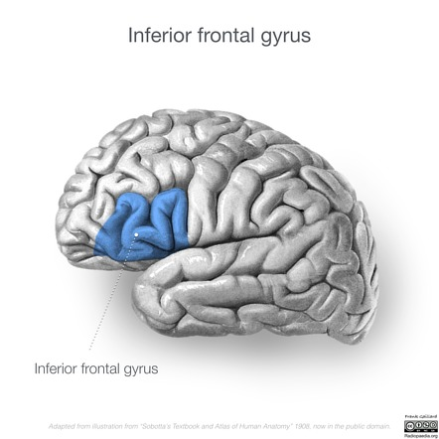
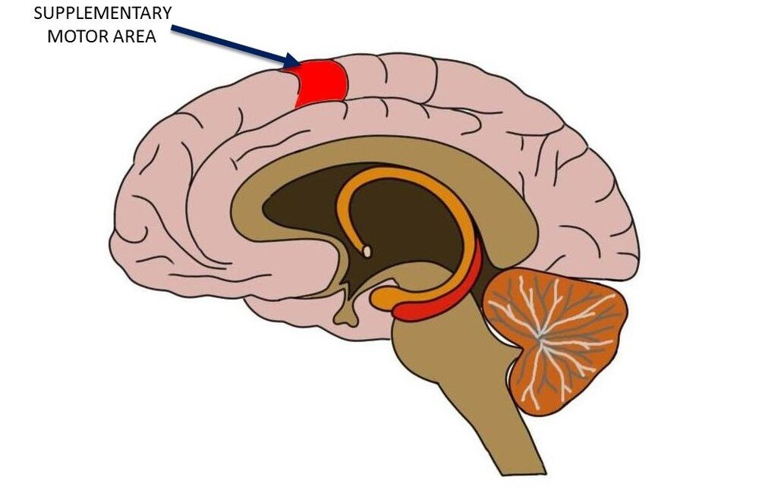
portion of the left inferior frontal gyrus involved in the retrieval and maintenance of semantic information, and in the supplementary motor area, which is involved in planning speech output.

Slide 9
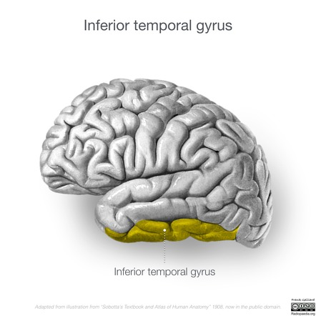
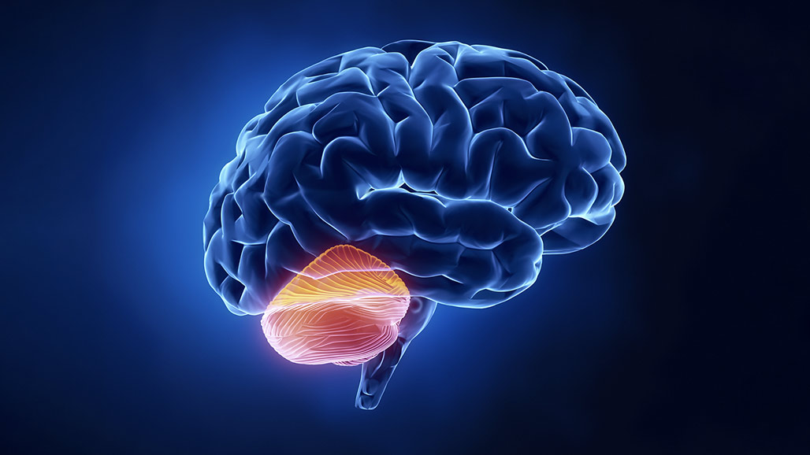
the left inferior temporal lobe, which is related to word-finding and semantic processing, and the cerebellum, which is a structure associated with action-pattern storage and refinement.

Slide 10
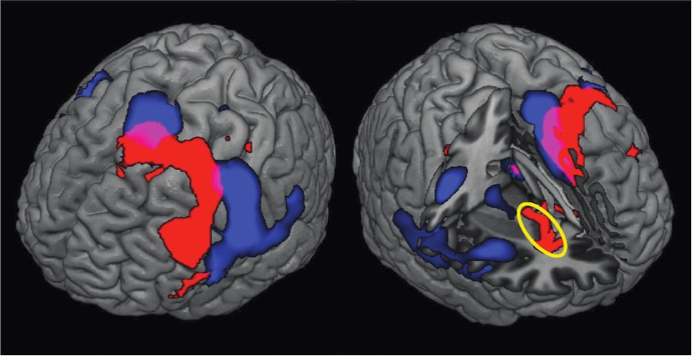
Basal ganglia

Slide 11
these are the structures that form the basis of our ability to:
select
plan
learn
and execute actions
Indeed, disorders of the basal ganglia are responsible for Tourette’s syndrome and Parkinson’s disease.

Slide 12
The "bilingual advantage"
There are also strong suggestions that lifelong bilingualism produces a cognitive reserve that is tapped when the brain suffers neurological insult, and that it can protect against the onset of symptoms of dementia, delaying them for several years.

Slide 13
Conclusion
“While we are yet far from being able to recommend the exercise of simultaneous interpretation as a means of enhancing cognition or staving off the effects of cognitive aging, our ongoing research aims to examine the potential benefits of developing expertise in this discipline”.
Authors

Slide 14
Follow-up questions
What do we mean by cognitive models of the interpreting?
The difference between translation and interpreting
Describe the research conducted for working memory and cerebral adaptations
Describe advantages of multilingual individuals

Slide 15
1. Rinne, J. O., Tommola, J., Laine, M., Krause, B. J., Schmidt, D., Kaasinen, V., . . . Sunnari, M. (2000). The translating brain: cerebral activation patterns during simultaneous interpreting. Neurosci Lett, 294(2), 85-88. doi: 10.1016/S0304-3940(00)01540-8
2. Hervais-Adelman, A., Moser-Mercer, B., Michel, C. M., & Golestani, N. (2015). fMRI of Simultaneous Interpretation Reveals the Neural Basis of Extreme Language Control. Cereb Cortex. doi: 10.1093/cercor/bhu158
3. Hervais-Adelman, A., Moser-Mercer, B., & Golestani, N. (2015). Brain functional plasticity associated with the emergence of expertise in extreme language control. Neuroimage, 114, 264-274. doi:10.1016/j.neuroimage.2015.03.072

